Slide 1
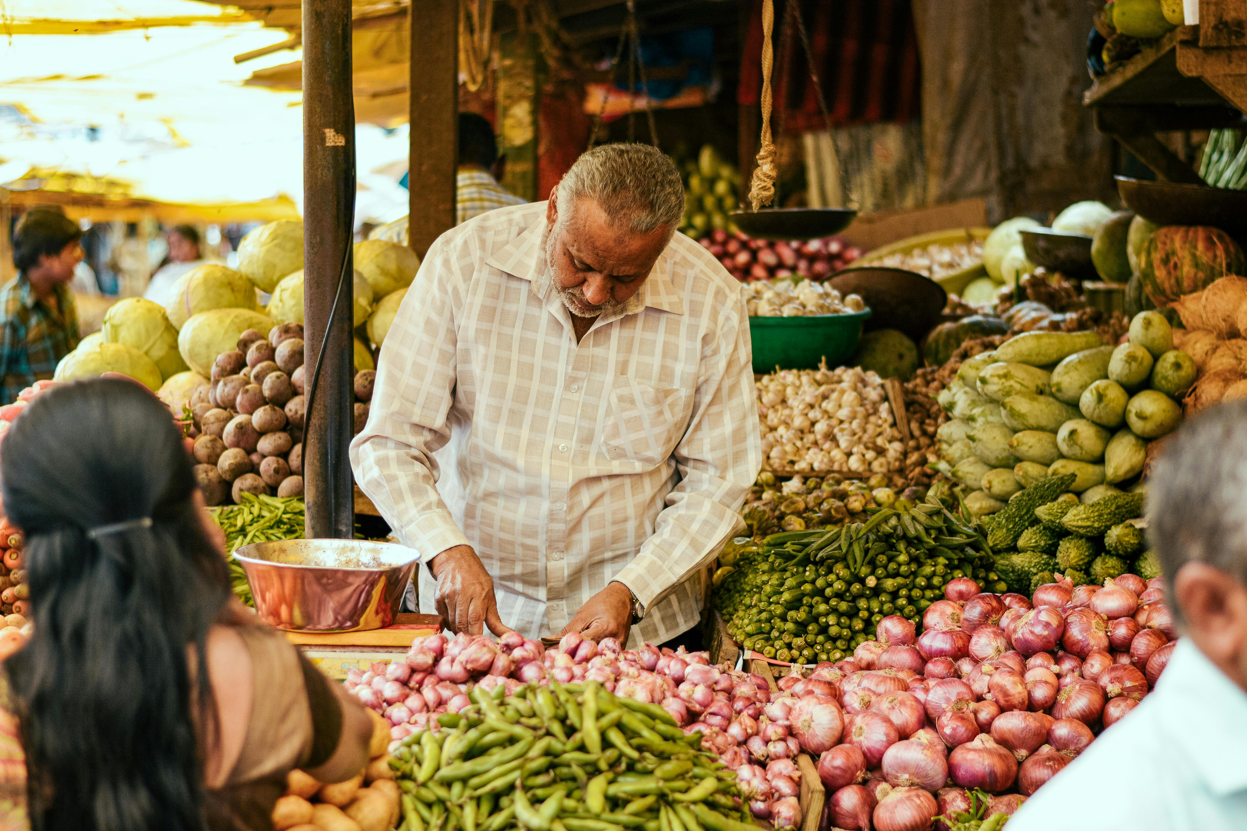
COMPANY NAME: MEGA-AGRO PRODUCTS ENTERPRISES Tagline: "Bringing the Taste of Home to the Diaspora."
Cofounders: Mr. Ezekiel Samuel and Mrs. Ezekiel Oluwadamilola
Date: 12th September, 2020

Slide 2
Problem Statement
Pain Point:
Diaspora communities often struggle to access authentic and high quality local foods from their home countries.
Statistics:
A growing number of diaspora populations seek familiar and nutritious produce, but face challenges in sourcing these products.

Slide 3
Solution
Product:
Mega-agro exports a wide range of agricultural products, including fruits, vegetables, and grains, to diaspora communities.
How It Works:
We connect local farmers with consumers abroad, ensuring quality and authenticity through reliable supply chains and custom packaging

Slide 4
Market Opportunity
Target Market:
Diaspora communities craving authentic local foods.
Market Size:
The global market for ethnic and specialty food products is expanding, with a significant and growing diaspora population.

Slide 5
Business Model
Revenue Streams:
Sales of agricultural products to individuals and businesses in the diaspora.
Partnerships with local stores and ethnic grocery chains.
Pricing Strategy:
Competitive pricing with options for premium products based on market research.

Slide 6
Traction
Milestones:
Established partnerships with local farmers and suppliers.
Successful initial shipments and positive customer feedback.
Growing customer base and repeat orders.
Metrics:
Increasing sales, expanding market reach, and strong customer satisfaction.

Slide 7
Competitive Analysis
Competitors:
Specialty food exporters and local ethnic food suppliers.
Differentiation:
Focus on quality control, authenticity, and personalized service for diaspora communities.

Slide 8
Team
Key Members:
Team Strengths:
Mr. Ezekiel Samuel, Founder – Background in agricultural exports and market expansion.
(Email: megaagro@gmail.com, Phone: 09012713755)
Mrs. Ezekiel Oluwadamilola, Cofounder – Expertise in business development and strategy.
(Email: gistwitsheila@gmail.com, Phone: 08037211323)
Mr. Seun, Operations Manager – Expertise in supply chain management.
Mr. Victor, Sales & Marketing Lead – Experience in marketing ethnic food products.
Deep industry knowledge, strong connections with local farmers, and dedication to serving diaspora communities.

Slide 9
Financial Projections
Revenue Forecast:
Projected steady growth over the next 35 years.
Key Metrics:
Customer acquisition cost, lifetime value, and projected profit margins

Slide 10
Funding Needs
Amount Needed: The amount needed for the business is
#5 million naira (Nigeria currency)
Use of Funds:
Scaling operations and logistics.
Expanding marketing efforts.
Investing in technology for improved supply chain management.

Slide 11
Closing
Call to Action: We invite you to be part of our mission to connect diaspora communities with the flavors of home. Contact us to discuss investment opportunities and partnerships.
Contact Information:
Mr. Ezekiel Samuel, Founder (Email: megaagro@gmail.com, Phone: 09012713755)
Mrs. Ezekiel Oluwadamilola, Co-founder
(Email: gistwitsheila@gmail.com, Phone: 08037211323)

